Slide 1
Spring 2017 CSE 5911
Strategic Operations Center
Final Presentation
Cyriac Domini, Daniel Bedich, Shantanu Bhardwaj, Asanka Nanayakkara

Slide 2
NetJets Flight Dashboard
Project Name: Strategic Operation Center
Point of Contact
Umesh Vaswani
Software Architect at NetJets
Perumal Ramasamy
Professor and VP at NetJets

Slide 3
Problem Statement
“Our organization has hundreds of flights that are flown each day. We would like to build an application that is a dashboard of our critical flights, with ability to identify critical issues. And this tool shall have the ability for the SOC members to communicate among themselves to resolve critical issues. The application shall have the following features:”
a. Publish /subscribe functionality so that as the data changes, user’s screens are updated immediately. b. Tracking communication among SOC members and associating communications with key entities c. Dashboard for flights to identify critical issues d. Ability to search past communications

Slide 4
Problem Statement - Simplified
Create a dashboard that displays flights with critical issues and their possible backups, has chat capabilities, and has real time view updates.

Slide 5
In Scope
Adding critical flights
Adding/Removing recovery options
Accepting a recovery option
Filtering/Searching flights
User authentication
User based flight decisions
Chat
User based (General and Role)
Entity based (Flight)
Automatic update functionality

Slide 6
Out of Scope
Integration with NetJets databases
Active directory group sign in (SSO)
Searchable chat
Customized dashboard views for different roles
Gorgeous UI
International flights
Search recovery flights by ETA/ETD

Slide 7
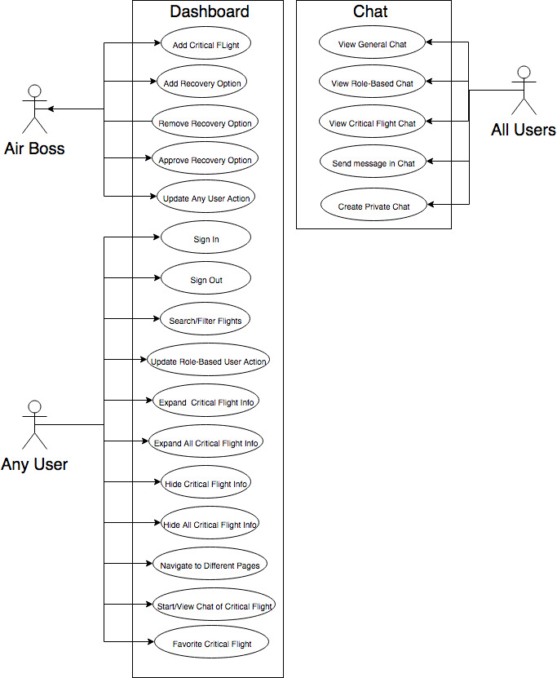
Use Case Diagram

Slide 8
Key Deliverables
Github repository with:
Finished Application with the following feature:
Login Page with proper functionality
Sample flights page with appropriate information
Working chat
Documentation
Final report
Software diagrams: class, architecture, use case, sequence
Assignments
Presentations
Poster
Notes
Reference Documentation

Slide 9
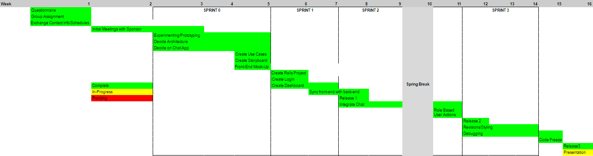
High-Level Plan

Slide 10
Dependencies
Auto UI updates
Rails 5 with ActionCable (websocket implementation)
Dashboard
jQuery Datatables
Ruby Gems
Devise, Json rails
FireBase/Firechat
OS/Software
Ubuntu 16.04 (or any UNIX based OS) with terminal and text editor
Rails 5
Heroku Server for deployment
Minitest testing framework

Slide 11
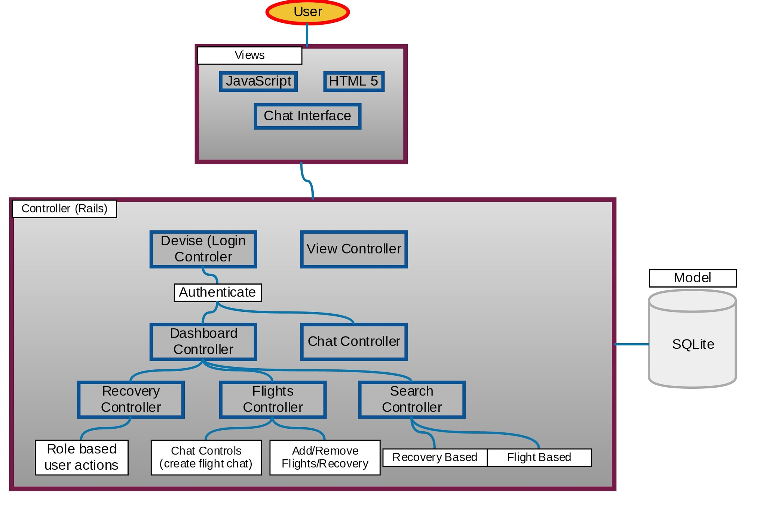
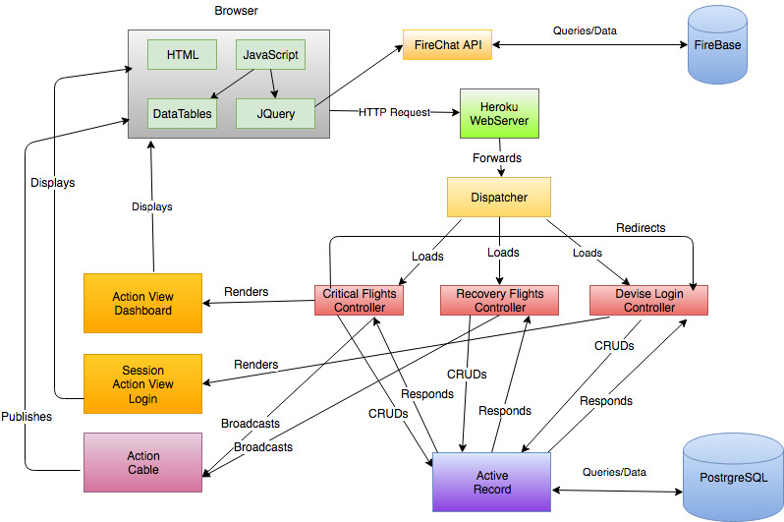
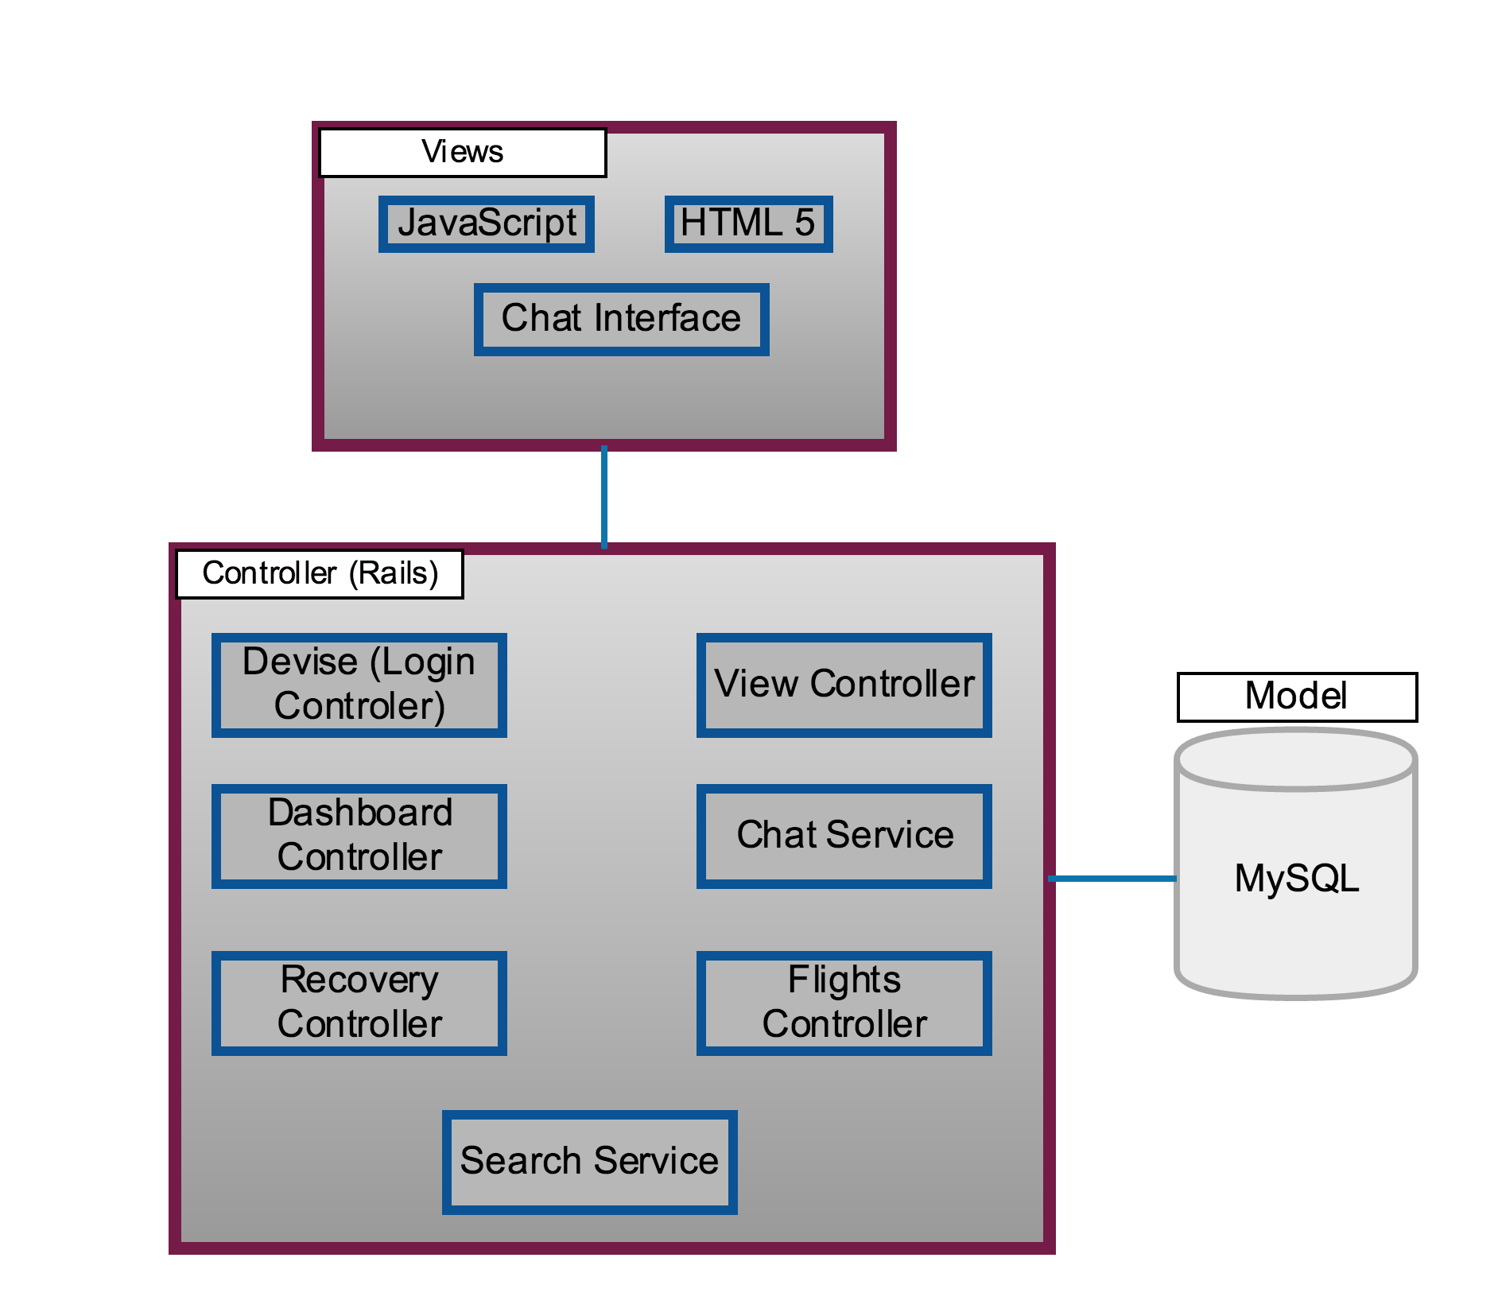
Architecture Diagram

Slide 12
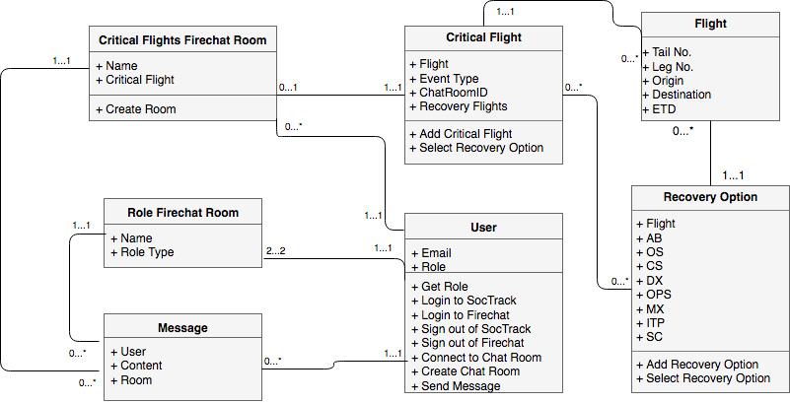
Class Diagram

Slide 13
Tasks Accomplished
Login Authentication
Fully Functional Dashboard
Adding Critical Flights
Adding/Removing Recovery Options
Accepting Recovery Options
Filtering/Searching Flights
User Actions
Firechat Integration
General, Role-based, Fight-based chats
Real Time updates through Action Cable utilities

Slide 14

Resources
Stack Overflow
ActionCable
JQuery DataTables
Google’s Firebase
Firechat
Sponsor

Slide 15
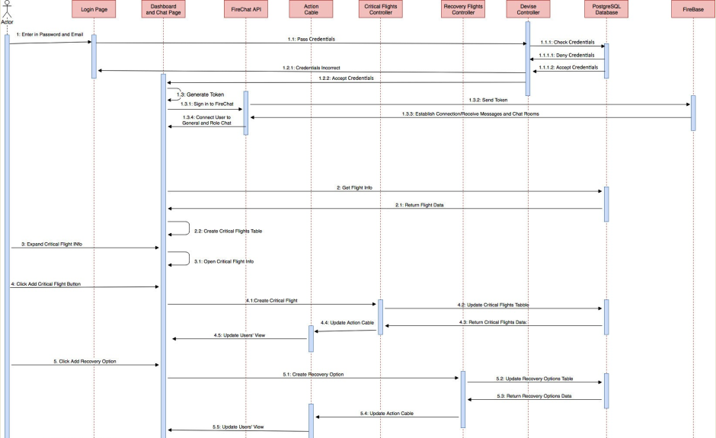
Sequence Diagram

Slide 16
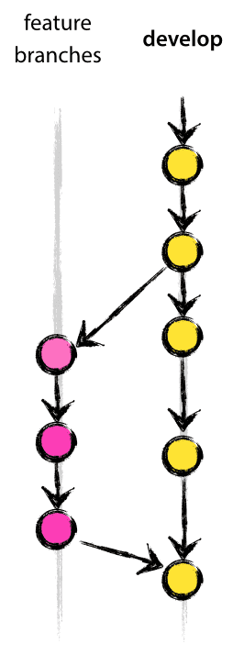
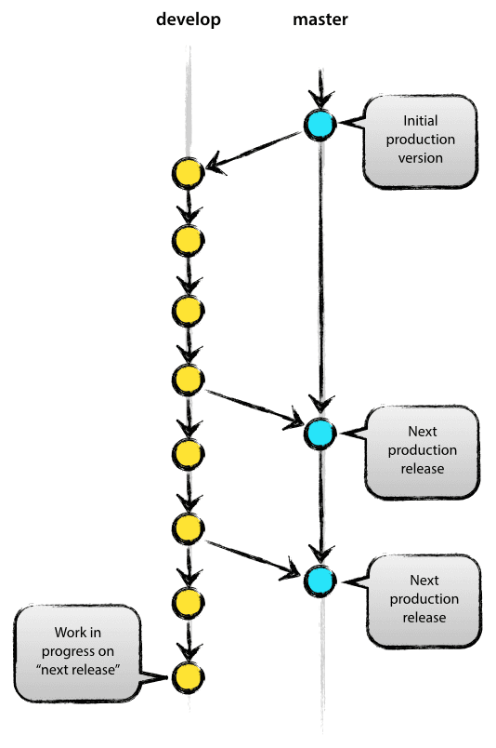
Project Management Methodology
Visual Studio Team Services
Git version control
Strict branching strategies
Agile
Frequent collaboration between team members
Unit Testing
Detailed documentation

Slide 17
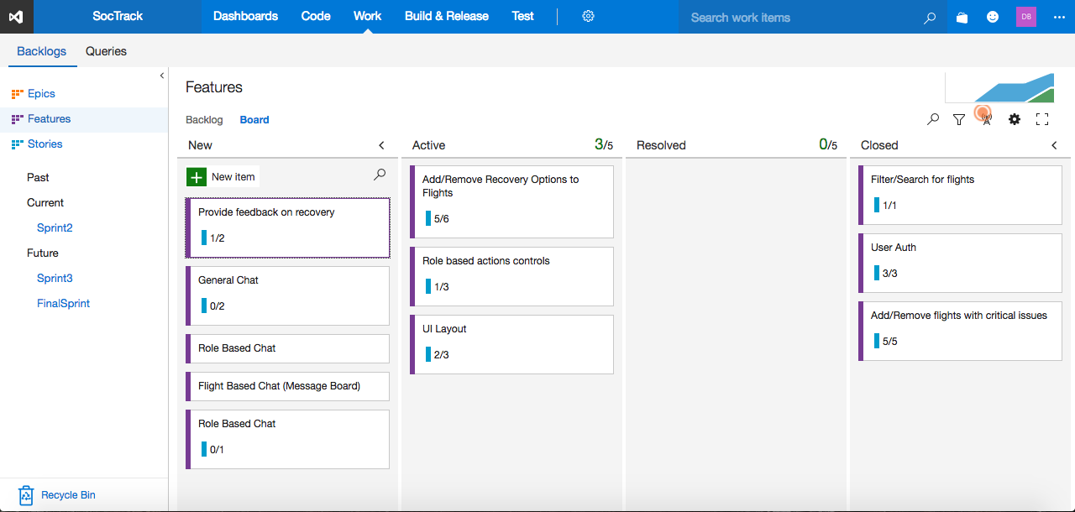
Visual Studio - Board

Slide 18
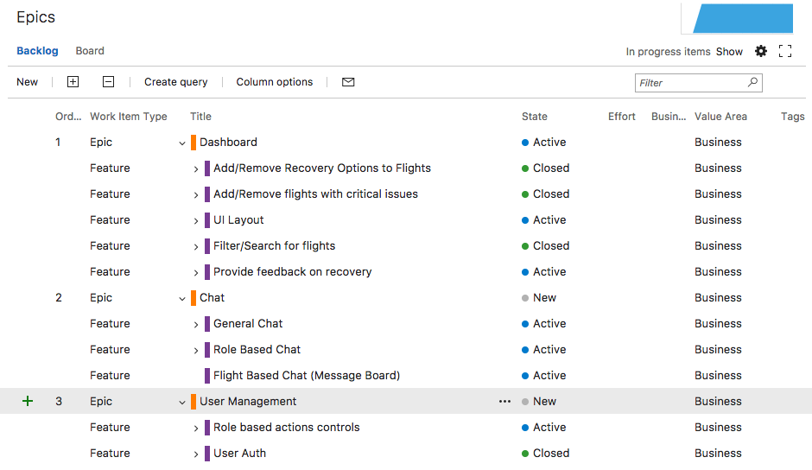
Visual Studio Board - Epics and Features

Slide 19
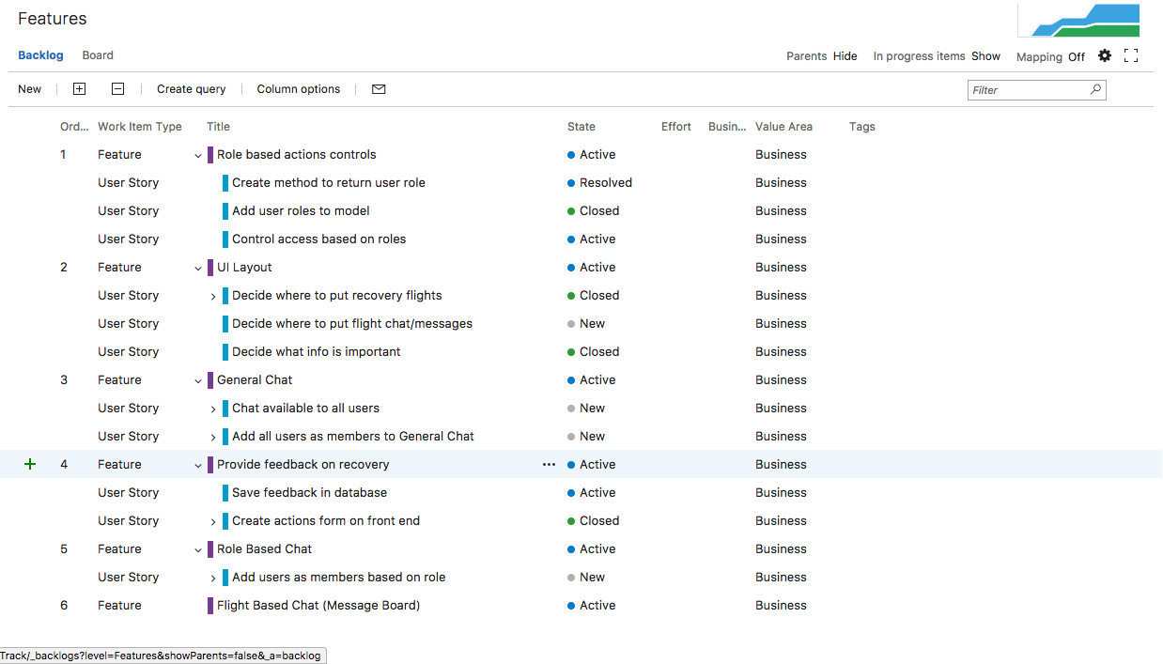
Visual Studio Board - Features and Stories

Slide 20
Testing
User Acceptance Testing
Asanka and Umesh
Helped finding and resolving bugs
Minitest for unit testing with ruby

Slide 21
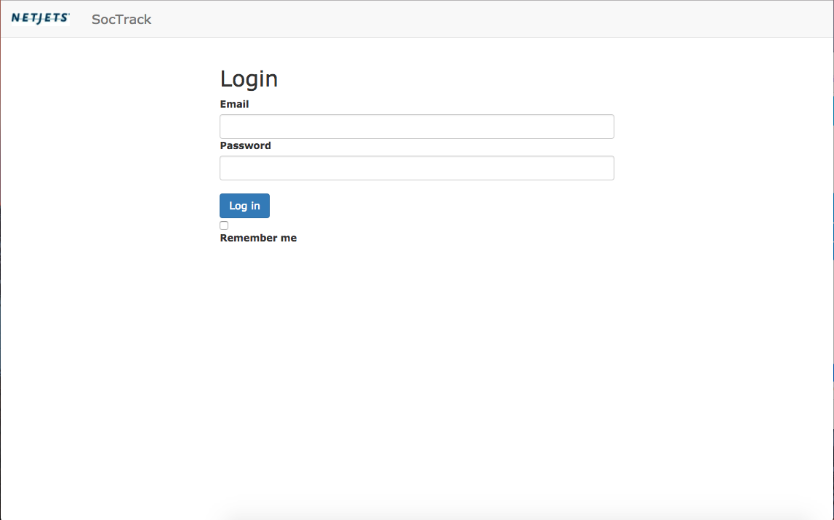
Screenshots - Login page

Slide 22
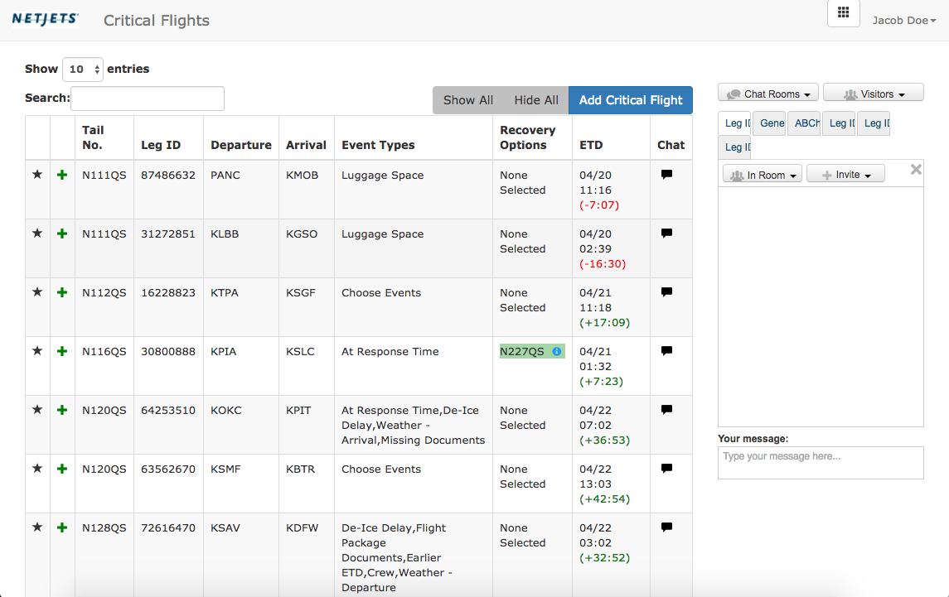
Screenshot - Dashboard

Slide 23
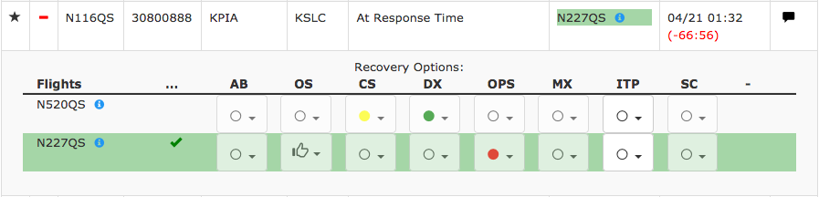
Screenshot - Expanded Critical Flight

Slide 24
Risks Encountered
Running out of time
Time Management
Taking Advantage of Spring Break
Forgoing Styling
Failing at Integrating Firechat/Needing to make our own chat
Change focus/pivot/revert to custom chat
Choosing an ideal testing methodology/software suite for integration, user, and unit testing
Trial and error, having the will to do it

Slide 25
Demo
soctrackdev.herokuapp.com

Slide 26
Enhancements and Expansions
Implementing favorites feature on frontend
Updating flight database to use better data (i.e. flights of current day)
Adding ability to remove chats
By user
Automatically after flight has already happened
Backlogging chats for search capabilities
Being able to unaccept recovery options
Disabling recovery options from other flights once accepted

Slide 27
Questions?

